Slide 1
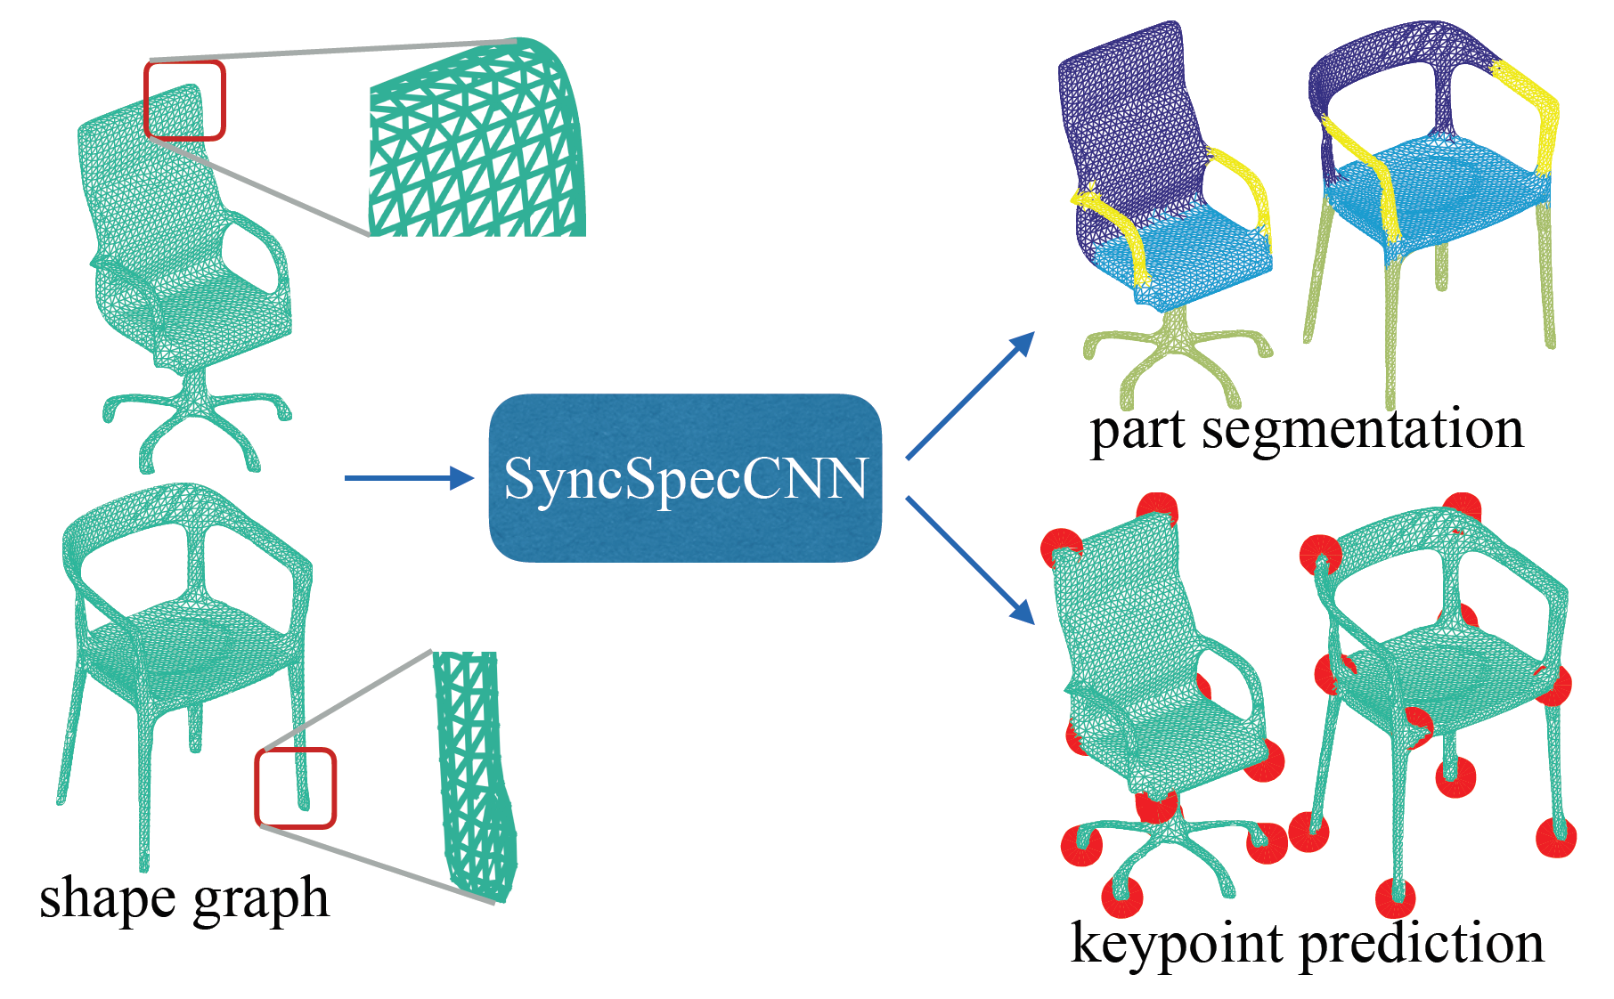
Synchronized Spectral CNN

Slide 2
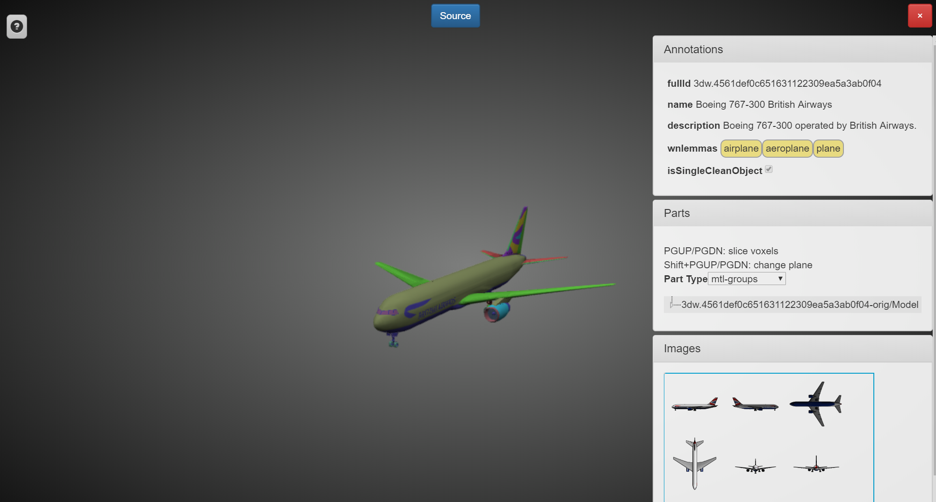
ShapeNet database
L. Yi, V. G. Kim, D. Ceylan, I.-C. Shen, M. Yan, H. Su, C. Lu, Q. Huang, A. Sheffer, and L. Guibas. A scalable active framework for region annotation in 3d shape collections. SIGGRAPH Asia, 2016

Slide 3
Main Idea
K-nearest neighbour graph
K=6
Weight inverse of squared distance
Spectral domain transformation
Symmetric normalized graph Laplacian
Smallest 100 eigenvalues
Spectral dilated kernel parameterization
Modulated exponential window
Functional mapping for synchronization
15 X 45
C=50
Reduced bases
Initialized by precomputed models
M. Ovsjanikov, M. Ben-Chen, J. Solomon, A. Butscher, and L. Guibas. Functional maps: a flexible representation of maps between shapes. ACM Transactions on Graphics (TOG), 31(4):30, 2012

Slide 4
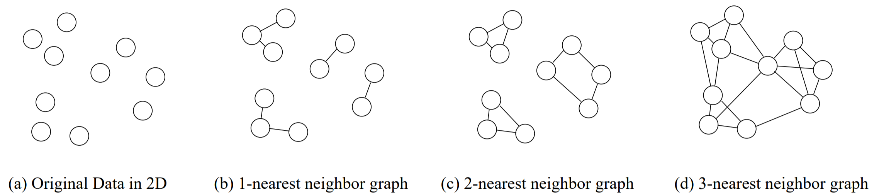
K nearest neighbour graph

Slide 5
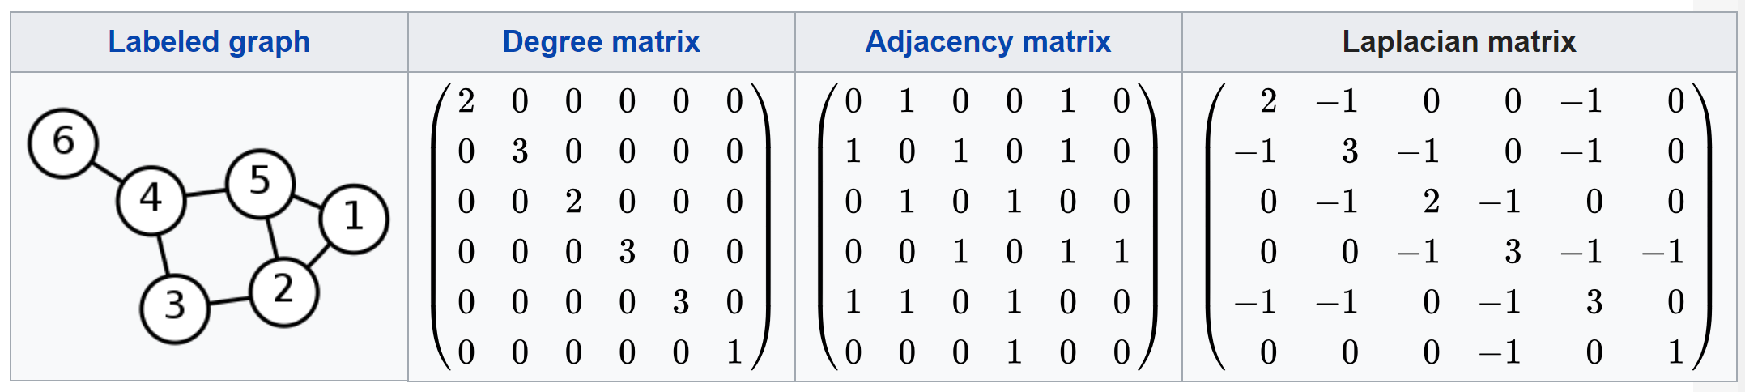
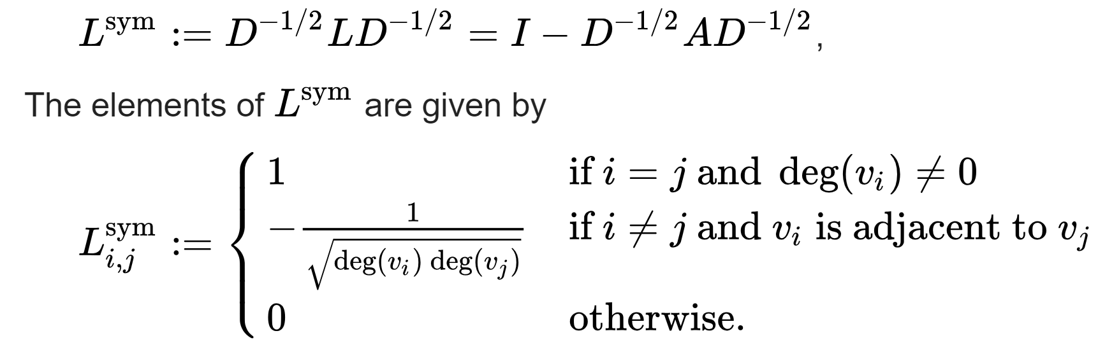
Graph Laplacian Eigenbases
The Graph Laplacian Matrix (Advanced) | Stanford University
https://www.youtube.com/watch?v=FRZvgNvALJ4

Slide 6
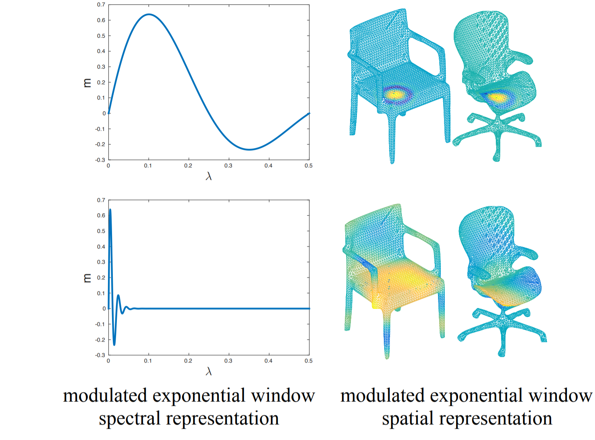
Spectral multiplication

Slide 7
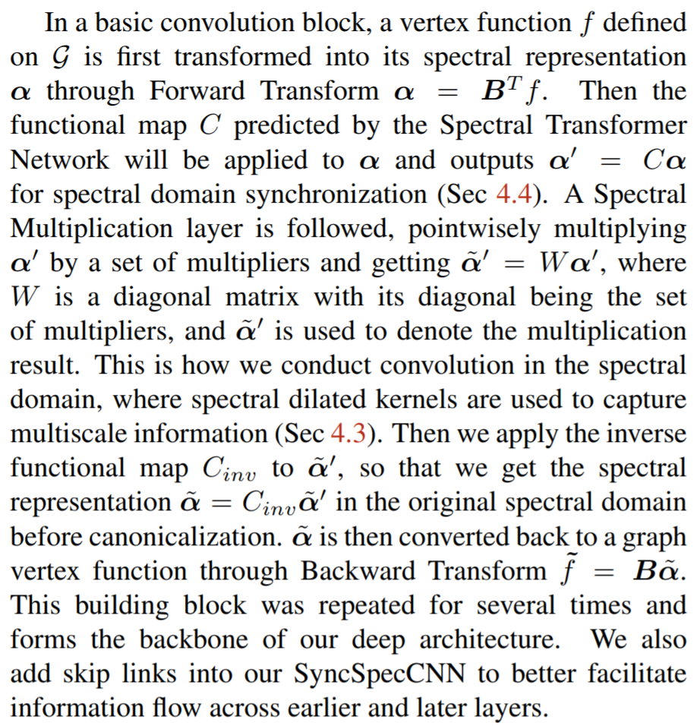
Formulation

Slide 8
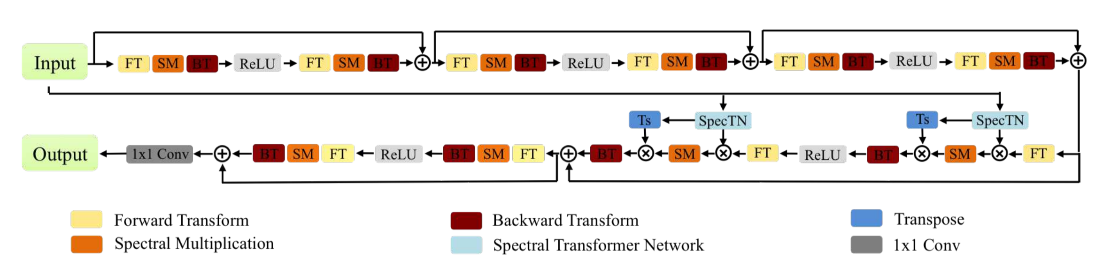
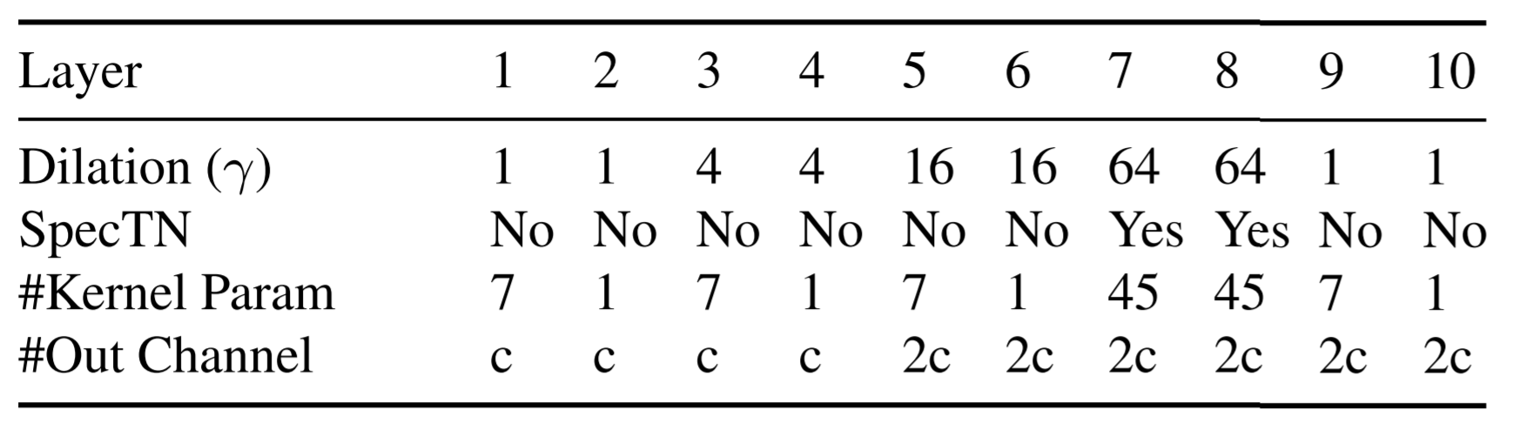
Network Architecture
M. Ovsjanikov, M. Ben-Chen, J. Solomon, A. Butscher, and L. Guibas. Functional maps: a flexible representation of maps between shapes. ACM Transactions on Graphics (TOG), 31(4):30, 2012

Slide 9
